Slide 1
Handout on compliance and ac load line
ECE 322L

Slide 2
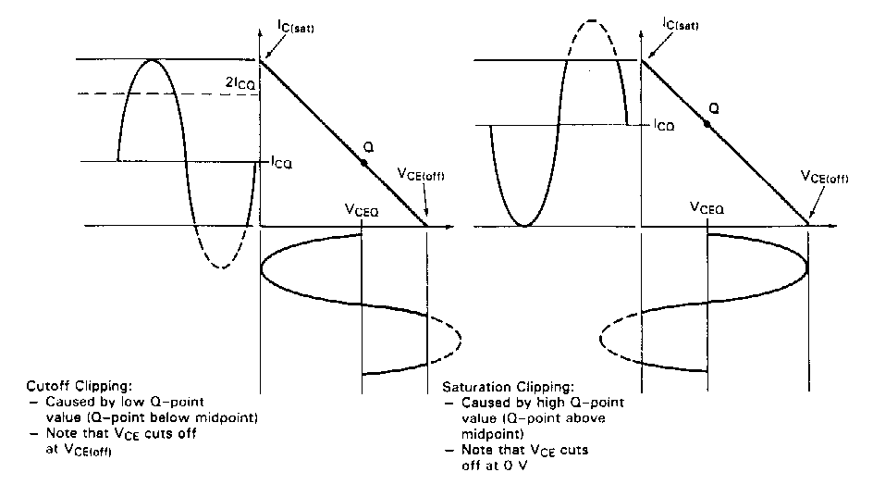
Cutoff and Saturation Clipping
When determining the output compliance for a given amplifier, solve both equation (A) and (B). The lower of the two results is the compliance of the amplifier.

Slide 3
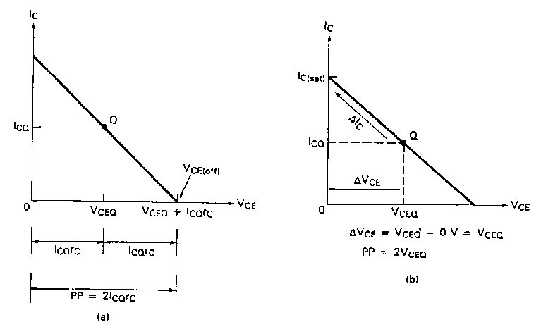
Compliance

Slide 4
Compliance
The maximum possible transition for V_{CE} is equal to the difference between V_{CE(off)} and V_{CEQ}. Since this transition is equal to I_{CQ}r_{C}, the maximum peak output voltage from the amplifier is equal to I_{CQ}r_{C}. Two times this value will give the maximum peak-to-peak transition of the output voltage:
V_{PP} = the output compliance, in peak-to-peak voltage
I_{CQ} = the quiescent value of I_{C}
r_{C} = the ac load resistance in the circuit
V_{PP} = 2I_{CQ}r_{C}
(A)

Slide 5
Compliance
When I_{C} = I_{C(sat)­}, V_{CE} is ideally equal to 0V. When I­_{C} = I_{CQ}, V_{CE} is at V_{CEQ}. Note that when I_{C} makes its maximum possible transition (from I_{CQ} to I_{C(sat)}), the output voltage changes by an amount equal to V_{CEQ}. Thus the maximum peak-to-peak transition would be equal to twice this value:
Equation (A) sets the limit in terms of V_{CE(off)}. If the value obtained by this equation is exceed, the output voltage will try to exceed V_{CE(off)}, which is not possible. This is called cutoff clipping, because the output voltage is clipped off at the value of V_{CE(off)}.
Equation (B) sets of the limit in terms of I_{C(sat)}. If the value obtained by this equation is exceed, the output will experience saturation clipping.
V_{PP} = 2V_{CEQ}
(B)

